Slide 1

UBS HACKATHON
Problem statement #3:EASY APPLY

Slide 2
Team Name: CODE FREAK
1.Harsh Said
2.Rakesh Visave
3.Ritika Garad
4.Priti Patil

Slide 3
Problem statement
Easy Apply
Develop a solution that can enable Recruitment team and Hiring managers to reduce the turnaround time for hiring the right talent from the market without investing lot of time and efforts in lot of manual steps of profile screening and saving a lot of money to hire external recruitment agencies to close the Business critical roles.

Slide 4
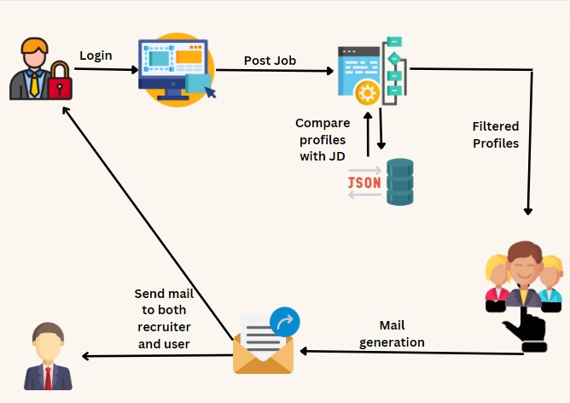
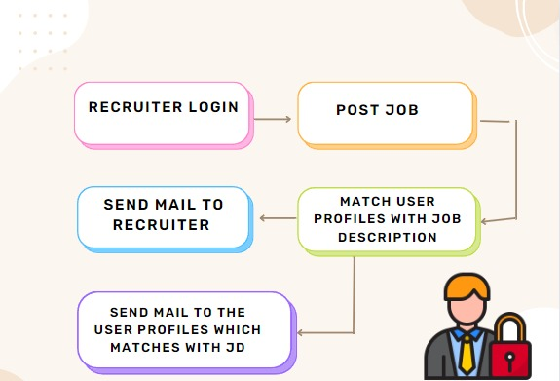
Solution Design

Slide 5
Scope Of Project
Recruiter will get to know the best match for job posts according to skill set.
Job profiles which matches with the job description will get an mail.
Website is specially designed for recruiting team.

Slide 6



Tech Stack
Frontend
Database
Backend

Slide 7
Potential Areas Of Expansion (Future Scope)
ML Model Integration:
To match the profiles with more accuracy and by considering entire profile we can add ML model. It will generate perfect match. This ML model can be integrated with the this project.
Keyword Extraction From Resume:
In the current implemented project we are comparing the job profile with job description. It can be improved by adding resume keyword extraction feature.

Slide 8
Challenges Faced
Handling Pressure: As we were given 2 days to develop a solution to our problem statement. It was little tough for us to implement all the extra features.
Sending mail was not easy though it seems easy. Google has been disabled the function of less app secure option for security reasons.

Slide 9




Key Learning Outcomes
Time Management
Environment
Experience
Collaborative Work

Slide 10
References
https://www.linkedin.com/
https://www.naukri.com/
https://beta.reactjs.org/learn/react-developer-tools
https://nodejs.org/en/
https://www.mongodb.com/

Slide 11
Demonstration

Slide 12
THANK YOU

